Slide 4
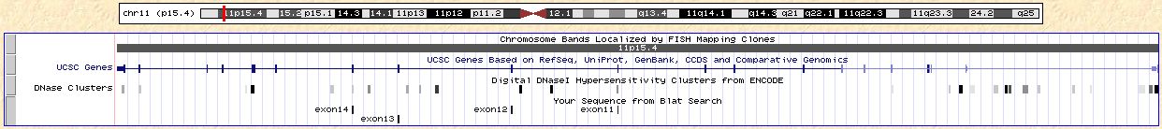
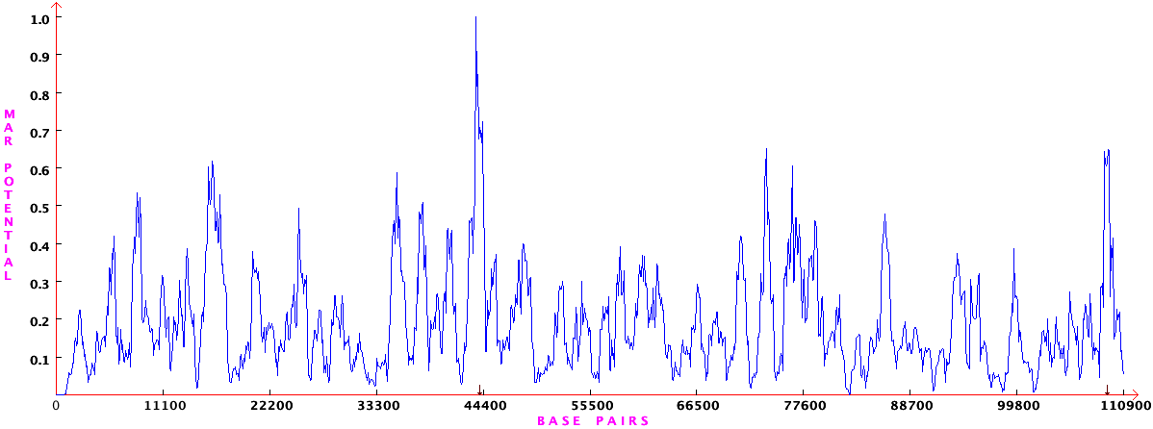
A
B
Figure 1: NUP98 gene chromatin structure. A – UCSC genome browser⁶⁴ tracks displaying NUP98 gene structure (most commonly translocated region, exons 11 to 14, marked) and DNAse I hypersensitivity sites. B – S/MAR enrichment on NUP98 gene, defined by MARFinder.⁶⁵
A
B
Figure 2: A – Nup98 protein domains and known interactions²¹ B – DNA stained with DAPI (blue) and GFP-Nup98 (green) expressed in 293T cells visualized by immunofluorescence microscopy.

Slide 5
Figure 3: GO annotation biological process enrichment for all genes differentially expressed in the presence of Nup98 fusion proteins.
Figure 4: GO annotation biological process enrichment for all TFs with TFBS enriched in genes differentially expressed in the presence of Nup98 fusion proteins.

Slide 6
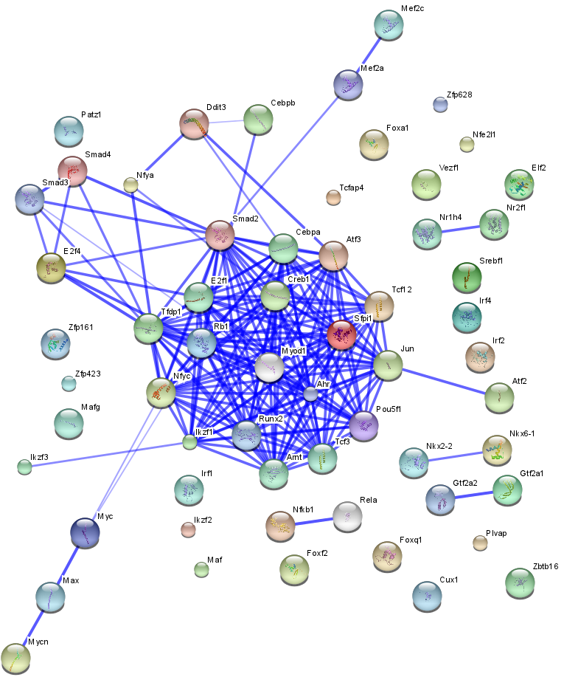
Figure 5: Protein-protein interaction network of TFs with TFBS enriched in genes differentially expressed in Nup98 translocations.

Slide 7
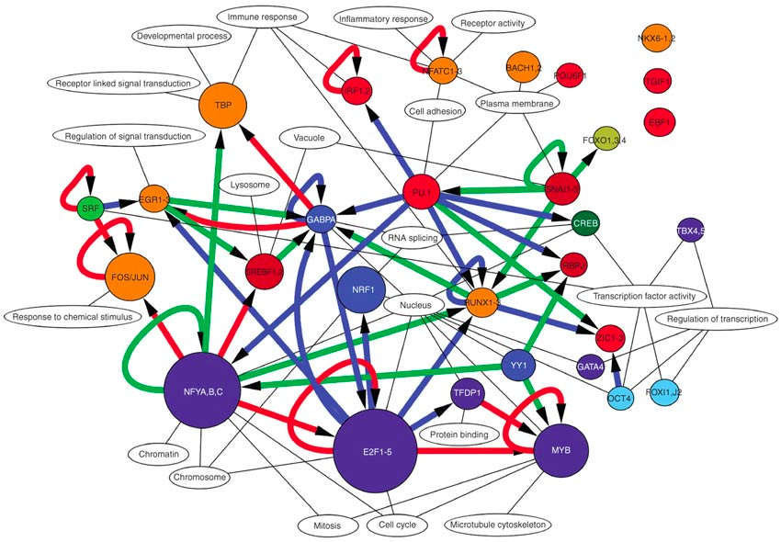
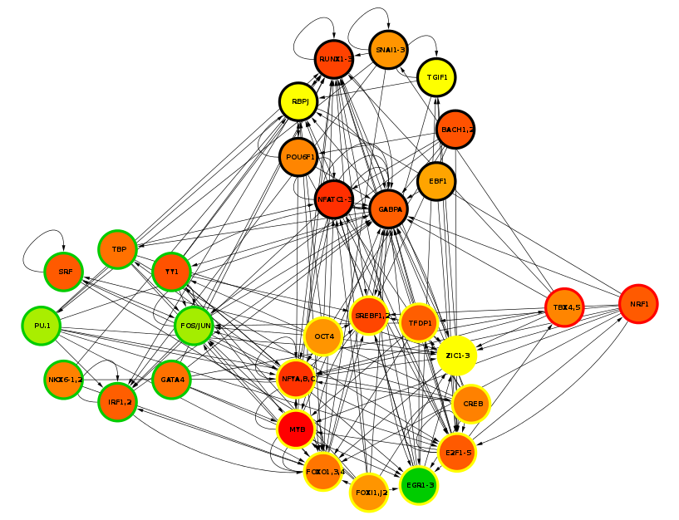
A
B
Figure 6: A - The transcriptional network that controls growth arrest and differentiation in a human myeloid leukemia cell line.⁴⁶ B – Superposition of results from Nup98 fusion microarrays into the network from A, node color indicates expression level of TF (red – decreased, green – increased) and node border indicates enrichment of TFBS in groups of genes with increased (green) or decreased (red) expression (yellow border - TFBS present in up and down regulated genes, black – TFBS absent in deregulated genes).

Slide 8
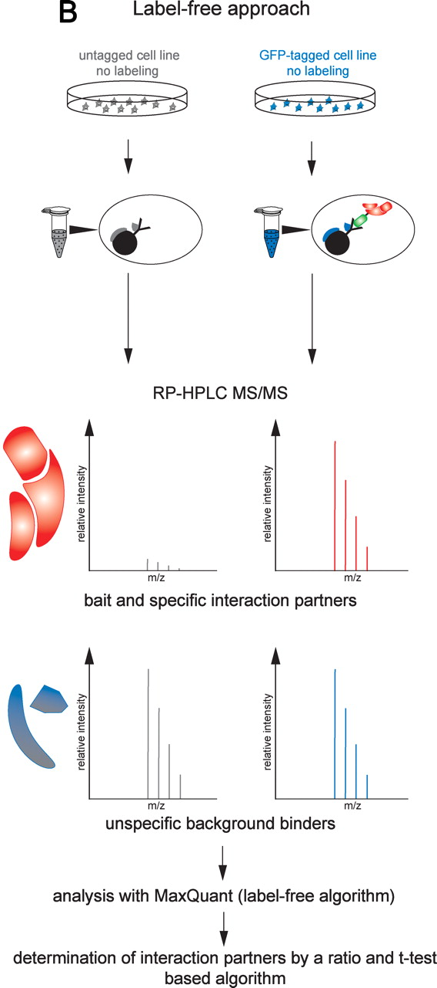
Figure 7: Protocol overview for affinity purification and label-free mass spectrometry quantification of protein complexes.⁵⁴

Slide 9
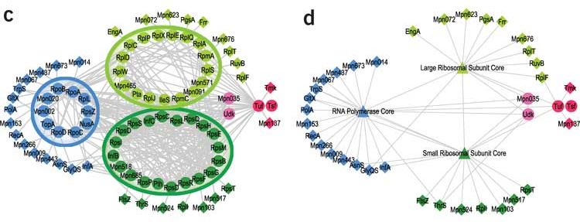
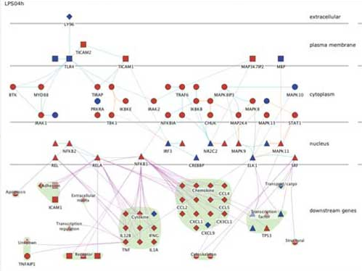
Figure 8: PPI network examples.⁶⁶ Exemplifying biological process enrichment, important network hubs and protein complexes distributed according to cellular compartments.

Slide 10
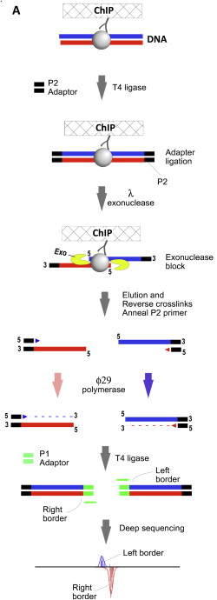
Figure 9: Protocol overview of ChIP-exo method followed by deep sequencing.⁵⁹

Slide 11
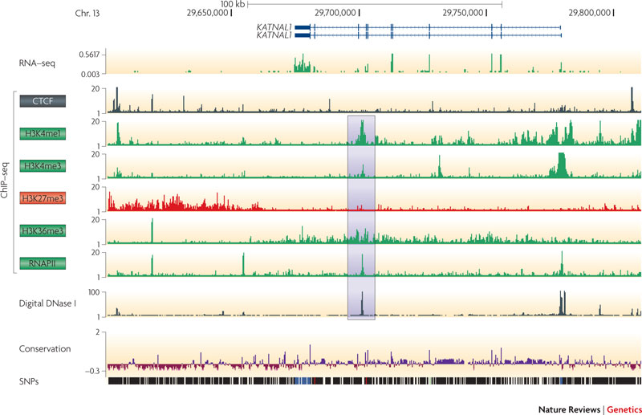
Figure 10: ChIP-seq results in a genome map example visualized in UCSC genome browser.⁶⁷

Slide 12
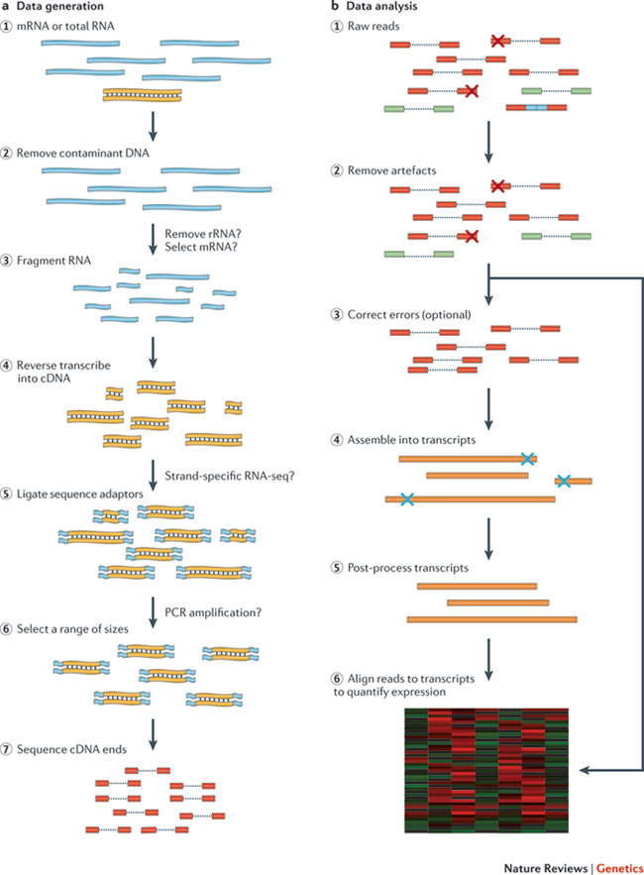
Figure 11: Next generation RNA-seq protocol overview.⁶⁸

Slide 13
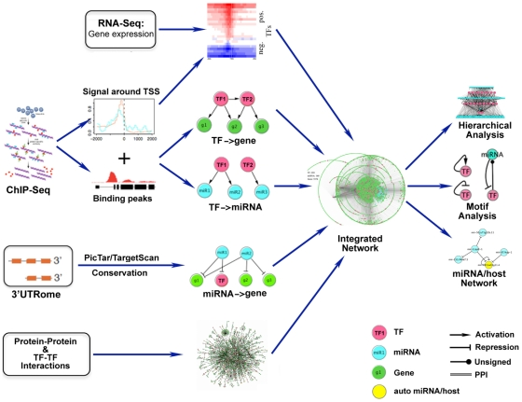
Figure 12: Data collection, integration and analysis for construction of a gene expression regulatory network.⁶⁹

Slide 14
A
B
Figure S1: GO annotation biological process enrichment for genes with expression down-regulated (A) or up-regulated (B) in the presence of Nup98 fusion proteins.

Slide 15
A
B
Figure S2: GO annotation biological process enrichment for TFs with TFBS enriched in genes with expression up-regulated (A) or down-regulated (B) in the presence of Nup98 fusion proteins.

Slide 16
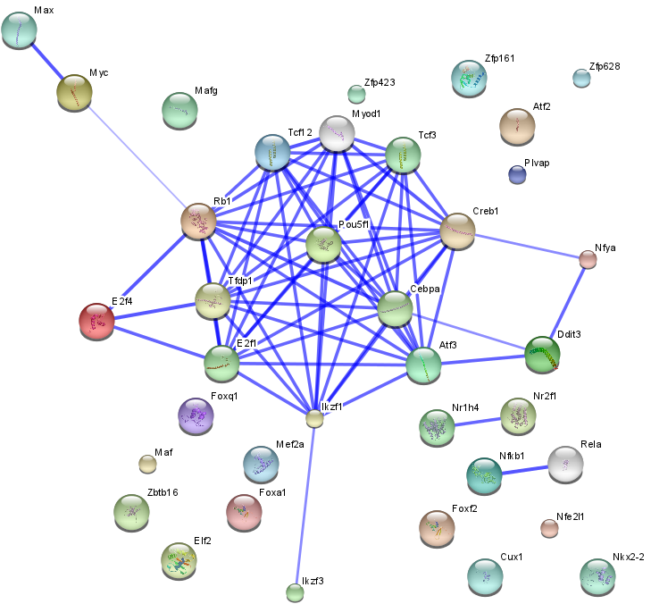
Figure S3: Protein-protein interaction network of TFs with TFBS enriched in genes with down-regulated expression in Nup98 translocations.

Slide 17
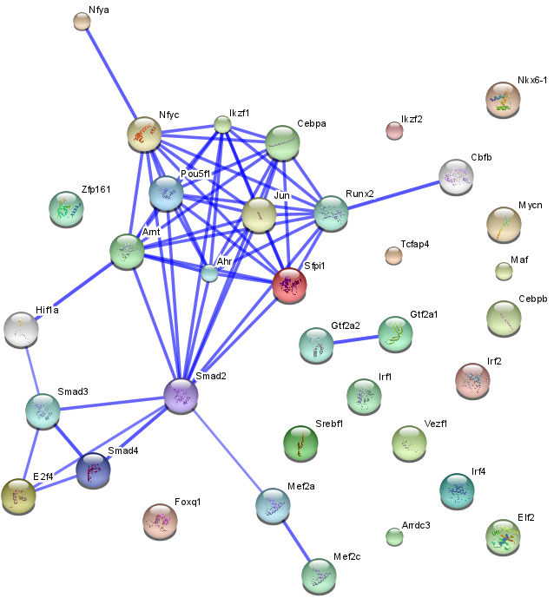
Figure S4: Protein-protein interaction network of TFs with TFBS enriched in genes with up-regulated expression in Nup98 translocations.

